Slide 1
NUMERIC TYPES

Slide 2
Outline
Major Concepts
  Hexadecimal, Binary, Decimal
  Integer
  floating point
  internal representation/size
  show how to perform reliable arithmetic computations

Slide 3
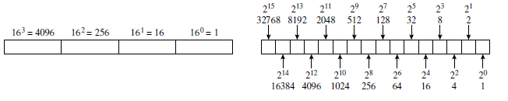
Number Systems and Number Representation (cont)
Place values for base 16 (hexadecimal) are shown on the left; base-2 (binary) place values are on the right. Each hexadecimal digit occupies the same memory space as four binary bits because 2⁴ = 16.

Slide 4
Number Systems and Number Representation (cont)
Conversions:
  Hex to Decimal; Decimal to Hex
    e.g. FF₁₆ → 255₁₀; 17₁₀ → 11₁₆
  Hex to Binary; Binary to Hex
    e.g. FF₁₆ → 11111111₂; 00010001₂ → 11₁₆
  Binary to Decimal; Decimal to Binary
    e.g. 01100111₂ → 103₁₀; 153₁₀→10011001₂

Slide 5
Number Systems and Number Representation (cont)
Arithmetic Operations:
  Hex addition
    e.g. 1AB₁₆ + 21₁₆ = 1CC₁₆
  Hex subtraction:
    e.g. F2₁₆ – 1B₁₆ = D7₁₆
  Binary addition:
    e.g.
    01100111₂ or 103₁₀
    +00101001₂ or + 41₁₀
    10010000₂ or 144₁₀

Slide 6
Number Systems and Number Representation (cont)
Now, you try:
  Hex addition
    e.g. BAB₁₆ + 1DD₁₆ = ?₁₆
  Hex subtraction:
    e.g. DAD₁₆ – 1B₁₆ = ?₁₆
  Binary addition:
    e.g.
    01010111₂ or ?₁₀
    +00111011₂ or +?₁₀
    ?₂ or ?₁₀

Slide 7
Translating Unsigned Decimal to Binary
Example: 37₁₀ = ?₂
37 / 2 = 18 R 1
18 / 2 = 9 R 0
9 / 2 = 4 R 1
4 / 2 = 2 R 0
2 / 2 = 1 R 0
1 / 2 = 0 R 1
37₁₀ ➔ 1 0 0 1 0 1₂

Slide 8
Primitive Number Types
Primitive Types | Size in Bits | Range
byte | 8-bit integer | -128 to 127
short | 16-bit integer | -32768 to 32767
int | 32-bit integer | -2,147,483,648 to 2,147,483,647
long | 64-bit integer | (Approx) -9 x 10¹⁸ to 9 x 10¹⁸
float | 32-bit real number | (Approx) -3.4 x10³⁸ to 3.4 x10³⁸
double | 64-bit real number | (Approx) -1.7 x10³⁰⁸ to 1.7 x10³⁰⁸

Slide 9
Signed and Unsigned Integers
The difference is the interpretation of the leftmost bit in the number’s representation.
  For signed numbers, this bit indicates the sign of the value.
  In C and C++, for unsigned numbers, it is an ordinary magnitude bit.
  Two’s complement is used for signed integers in most modern computers

Slide 10
Example 2-Complement
For example, suppose we are given the short number
11111111 11010010
It is negative because it starts with a 1 bit. To find the magnitude we get the 2’s complement of these bits. Flip the bits and add 1:
00000000 00101101
add 1 +00000000 00000001
  00000000 00101110
and convert to its decimal form:
00000000 00101110 =
32+8+4+2 = 46.
So the original number is −46.

Slide 11
Translating Signed Decimal to Binary
Example: -65₁₀ = ?₂
Get 2’s compliment:
Get magnitude:65= 01000001₂
Flip bits: 10111110
Add 1: +1
-65₁₀ ➔ 10111111₂
Now, the reverse:
10111111₂ is what decimal?
Leftmost bit is on, so it
is negative. Take two’s
compliment, then add 1:
Flip bits: 01000000
Add 1: +1
-65₁₀ ⬅ 01000001₂
Magnitude is 65:

Slide 12
Floating-Point Types
In traditional scientific notation, we might write 1.4142 × 10⁻². A floating-point number is represented similarly inside the computer by a sign bit, a mantissa, and a signed exponent.
Each of the components of a real number is stored in some binary format
This representation uses 32 bits divided into three fields to represent a real value. The base, b = 2, is not represented explicitly; it is built into the computer’s floating-point hardware.

Slide 13
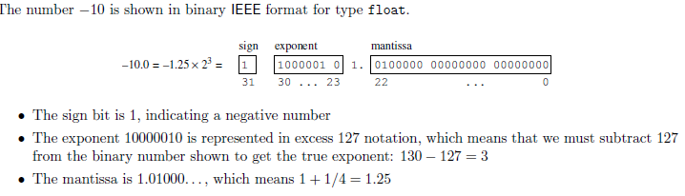
Representation of Real Numbers

Slide 14
Representation of Real Numbers
1 bit for sign 8 bits for exponent bias 127 23 bit mantissa
Example: -325.5₁₀ = ?₂
325₁₀ = ?₂
Multiply by 2 till a zero remainder:
0.5 X 2 = 1.0
101000101.1
Normalize the binary number (Scientific Notation):
1.010001011 X 2⁸
Exponent stored = Exponent Actual + 127
Exponent stored = 8 + 127
= 135₁₀ ➔ 10000111₂
Now, store the number in binary:
1 10000111 01000101100000000000000 Now, you do: -10.25 as a float.
Hex value: C3 A2 C0 00

Slide 15
Representation of Real Numbers
1 bit for sign 8 bits for exponent bias 127 23 bit mantissa
Example: -10.25₁₀ = ?₂
10₁₀ = ?₂
Multiply by 2 till a zero remainder:
0.25 X 2 = 0.5
0.5 X 2 = 1.0
1010.01
Normalize the binary number (Scientific Notation):
1.01001 X 2³
Exponent stored = Exponent Actual + 127
Exponent stored = 3 + 127
= 130₁₀ ➔ 10000010₂
Now, store the number:
1 10000010 01001000000000000000000
Hex value: C1 24 00 00

Slide 16
Excess 127 Notation
In the IEEE standard real format, the exponent is stored in excess 127 notation.
Here, the entire 8 bits are treated as a positive value, then the excess value, 127, is subtracted from the 8-bit value to determine the true exponent.
127 + 3 = 130, which is the value stored in the eight exponent bits. While this format may be complicated to understand, it has advantages in developing hardware to do quick comparisons and calculations with real numbers.

Slide 17
Numeric Output to a File
Here is a Java program that stores multiple numeric types to a file:
public class NumericOutput {
public static void main(String[] args) throws Exception {
File opfile = new File("NumericOutput.bin");
DataOutputStream dataStream = null;
PrintWriter output1 = new PrintWriter(opfile);
output1.println("Numeric data types:");
dataStream = new DataOutputStream(new FileOutputStream(opfile));
String name = "BYTE+127:";
dataStream.writeUTF(name);
byte byte01 = Byte.parseByte("127");
dataStream.writeByte(byte01);
name = "BYTE-128:";
dataStream.writeUTF(name);
byte byte02 = Byte.parseByte("-128");
dataStream.writeByte(byte02);

Slide 18
Numeric Output to a File
name = "SHORT-46:";
dataStream.writeUTF(name);
short short01 = Short.parseShort("-46");
dataStream.writeByte(short01);
name = "INTEGER AVERAGE:";
dataStream.writeUTF(name);
int grade01 = Integer.parseInt("99"), grade02 = Integer.parseInt("99"), grade03 = Integer.parseInt("100");
int intAverage = (grade01 + grade02 + grade03)/3;
dataStream.writeInt(intAverage);
name = "FLOAT AVERAGE:";
dataStream.writeUTF(name);
float fltGrade01 = 99, fltGrade02 = 99, fltGrade03 = 100;
float fltAverage = (fltGrade01 + fltGrade02 + fltGrade03)/3;
dataStream.writeFloat(fltAverage);
System.out.println("The float average of " + grade01 + " + " + grade02 + " + " + grade03 + " = " + fltAverage);

Slide 19
Numeric Output to a File
name = "DOUBLE AVERAGE:";
dataStream.writeUTF(name);
double dblGrade01 = 99, dblGrade02 = 99, dblGrade03 = 100;
double dblAverage = (dblGrade01 + dblGrade02 + dblGrade03)/3;
dataStream.writeDouble(dblAverage);
System.out.println("The double average of " + grade01 + " + " + grade02 + " + " + grade03 + " = " + dblAverage);
name = "FLOAT-325.5:";
dataStream.writeUTF(name);
float float01 = Float.parseFloat("-325.5");
dataStream.writeFloat(float01);
name = "FLOAT-10.25:";
dataStream.writeUTF(name);
float float02 = Float.parseFloat("-10.25");
dataStream.writeFloat(float02);
}
}
run:
The float average of 99 + 99 + 100 = 99.333336
The double average of 99 + 99 + 100 = 99.33333333333333
BUILD SUCCESSFUL (total time: 0 seconds)

Slide 20
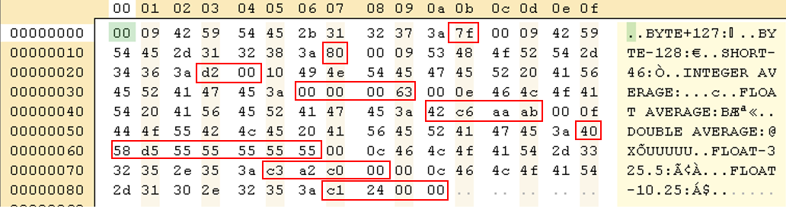
Numeric Output to a File

